Slide 1
Arm Cortex Architect
Apr 14, 2024

Slide 2
1. Environment - Installation
Window 11 Pro 64-bit (10.0, Build 22631)
Arm GNU Toolchain Version 13.2.Rel1: arm_gnu_link
gdb-multiarch-14.1: gdb_link
qemu-20240411: qemu_link
Musca-board b1 bare-metal project: Musca_link
GnuMake: gnumake_link

Slide 3
2. GDB
Command | Description
run or r | Executes the program from start to end.
break or b | Sets a breakpoint on a particular line.
disable | Disables a breakpoint
enable | Enables a disabled breakpoint.
next or n | Executes the next line of code without diving into functions.
step | Goes to the next instruction, diving into the function.
list or l | Displays the code.
print or p | Displays the value of a variable.
quit or q | Exits out of GDB.
clear | Clears all breakpoints.
continue | Continues normal execution
info b, info r | Displays information of a breakpoint or a register

Slide 4
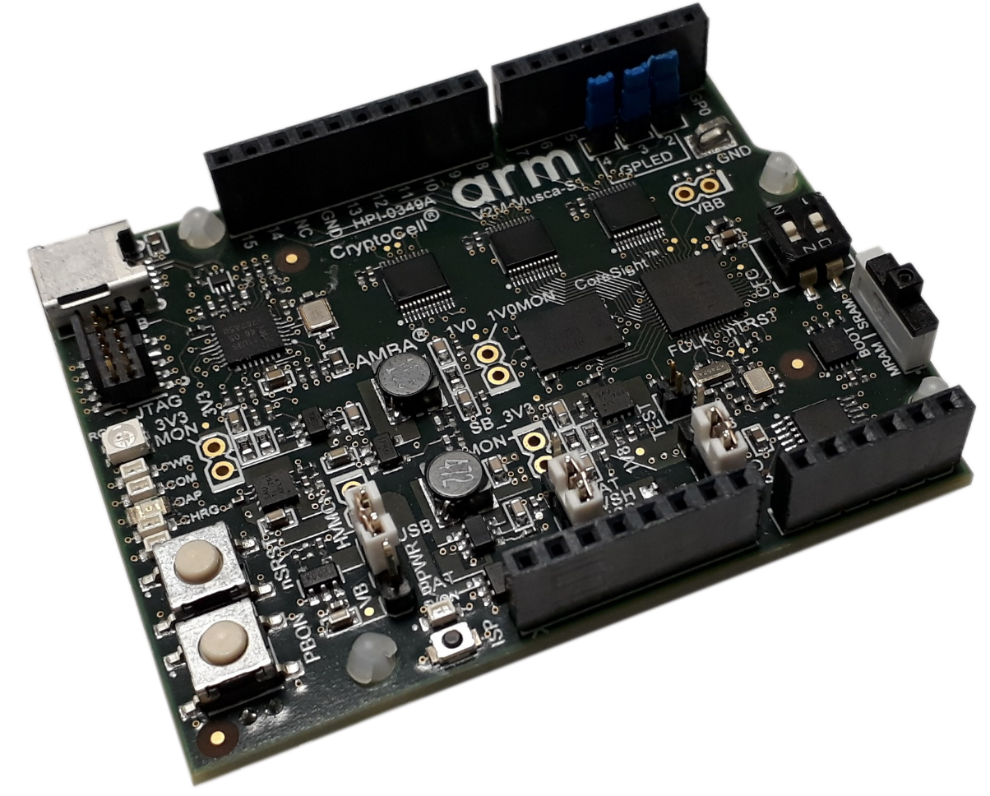
3. Musca B1 bare metal sample project

Slide 5
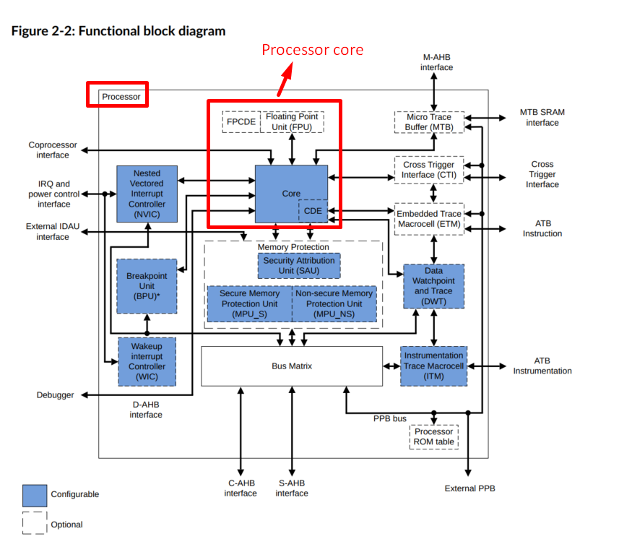
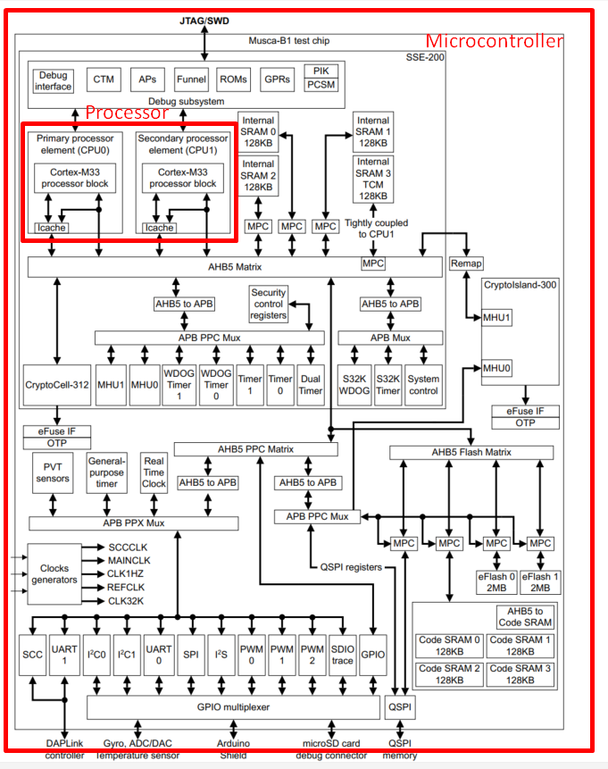
4. Processor core, processor and microcontroller

Slide 6
5. Operational modes of the Cortex-Mx processor
Type:
Thread mode
Handler mode
All your applications code will be executed under "Thread mode" of the processor. This is also called as "User Mode“.
Processor always starts with "Thread mode"
Whenever the core meets with the system exception or any external interrupts then the core will change its mode to handler mode in order to service the ISR associated with that system exception or the interrupt.

Slide 7
6. Access levels
Types:
Privileged level (PAL)
Full access to processor resources
Handler mode is always privileged
Thread mode is by default privileged, but can be changed to non-privileged
Non-privileged level (NPAL)
Restricted access
You can make thread mode to run in this level
You can use the CONTROL register of the processor if you want to switch between the access level

Slide 8
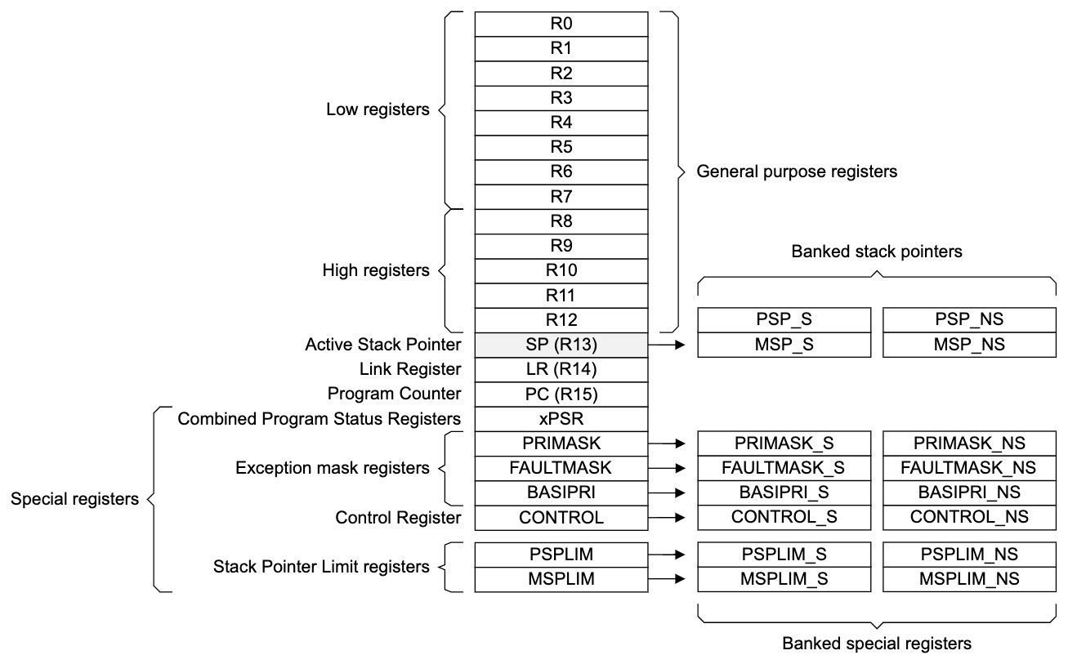
7. Core register

Slide 9
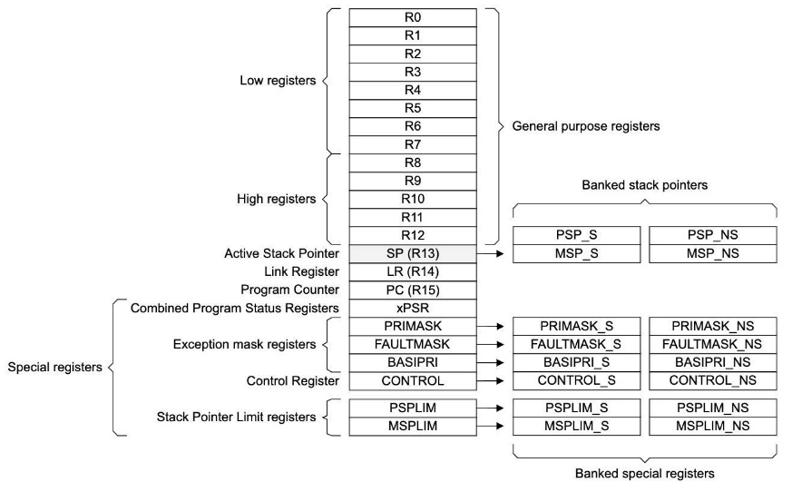
8. Memory mapped and non memory mapped registers of the microcontroller
The registers do not have unique addresses to access them. Hence, they are not part of the processor memory map
You cannot access these registers in a C program using address dereferencing
To access these register in C, you have to use assembly instruction
Every register has its address in the processor memory map
You can access these registers in a C program using address dereferencing
Register of the processor specific peripherals (NVIC, MPU, SCB, DEBUG, etc)
Register of the microcontroller specific peripherals (RTC, I2C, TIMER, CAN, USB, etc)
Non-memory mapped registers
Memory mapped registers

Slide 10
9. ARM GCC inline assembly code
Inline assembly code is used to write pure assembly code inside a C program

Slide 11
9. ARM GCC inline assembly code (cont)
Extended form of an inline assembler statement: refer link
__asm volatile (“MOV R0, R1”);
__asm volatile (“MOV R0, R1”:::);
__asm volatile (code : output operand list : input operand list : clobber list);
Each input and output operand is described by a constraint string followed by a C expression in parentheses
Input/output operand format:
“<Constraint strings>” (< C expression >)
Example 1: Move the content of C variable into Arm register R0
Example 2: Move the content of R0 register into C variable

Slide 12
10. Stack memory

Slide 13
11. Exception model
Anything disturbs the normal operation of the program by changing the operation mode of the processor
Type:
System exception (Exception): Are generated by the processor itself internally
Extenal interrupt (Interrupt): Come from the external world to the processor

Slide 14
11. Exception model - Exception
There is room for 15 system exceptions
Exception number 1 is Reset Exception (or Reset System Exception)
In an Arm v8-M PE with the Main Extension, 12 are implemented System Exceptions. 3 are reserved for future implementations
Exception number 16 is interrupt 0 (IRQ 0)
System control block (SCB) provides system implementation information and system control. This includes configuration, control and reporting of system exceptions.

Slide 15
11. Exception model - NVIC, Interrupt
NVIC (Nested Vector interrupt controller)
NVIC is one of the peripheral of the Cortex M processor core
It is used to configure up to 496 interrupts (Arm v8-M)
This is highly vendor specific and it is triggered by various on chip peripheral of the MCU like SPI, GPIO, UART, Timer...
Using NVIC registers to enable/disable/pending various interrupts and read the status of the active and pending interrupt
You can configure the priority and priority grouping of various interrupts
It is called as "Nested" because it supports pre-empting a lower priority interrupt handler when higher priority interrupt arrives

Slide 16
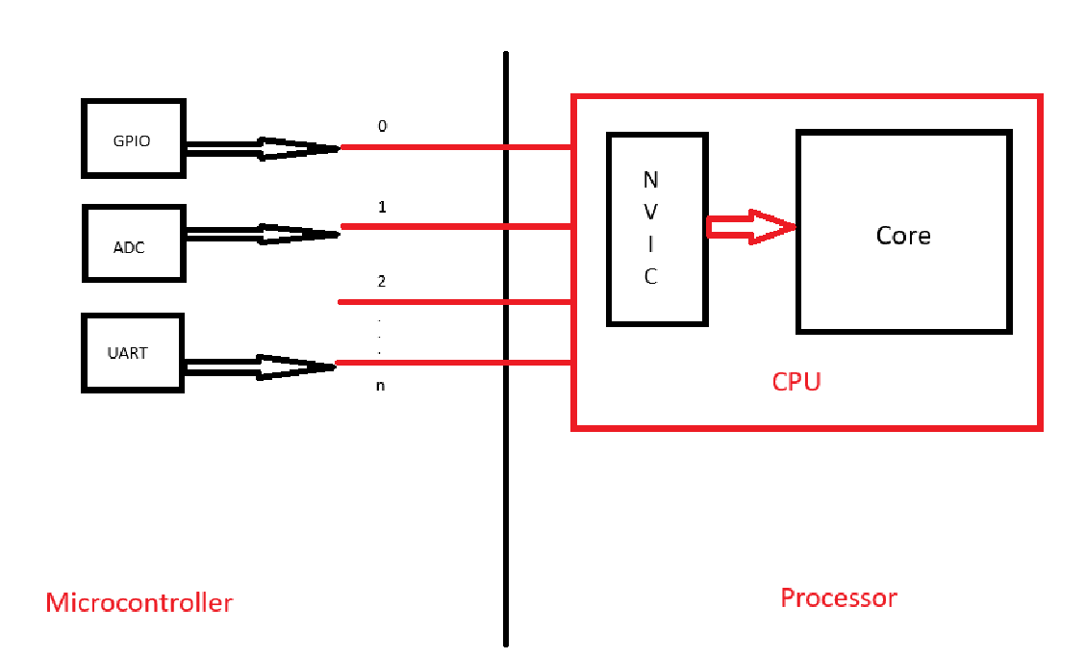
11. Exception model - NVIC, Interrupt (cont)

Slide 17
11. Exception model – Priority (Pre-Empt, Sub)
Priority means urgency.
The priority value is a measure of urgency.
Priority levels implement by the MCU vendors.
Pre-empt priority: When the processor is running interrupt handler, and another interrupt appears, then the pre-empt priority value will be compared, and interrupt with higher pre-empt priority (less in value) will be allowed to run.
Sub priority: This value is used only 2 interrupts with the same pre-empt priority values occur at the same time. In this case, the expectation with higher sub-priority (less in value) will be handled first.

